Slide 1
Managing MySQL database 2
Modifying/creating database structures and relationships
0360-270-91 Advanced web design
Abedalrhman Alkhateeb

Slide 2
Creating Extra columns for Profiles table
We are going to create 2 extra columns for Profiles table
Pictures to save the picture of the user
Pictures column (Attribute) will have BLOB (Binary large object) datatype to store the images
User code will be have an integer value to define the user level, e.g. User, admin, superuser .. Etc.

Slide 3
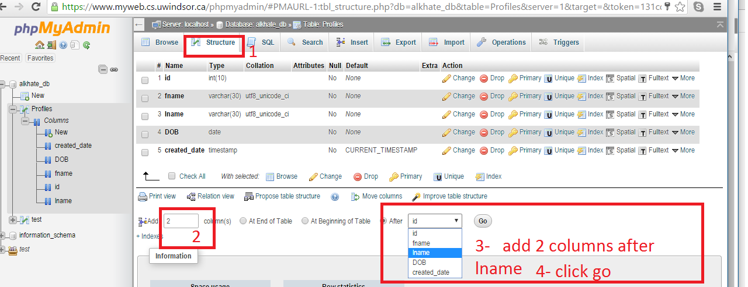
Creating Extra columns

Slide 4
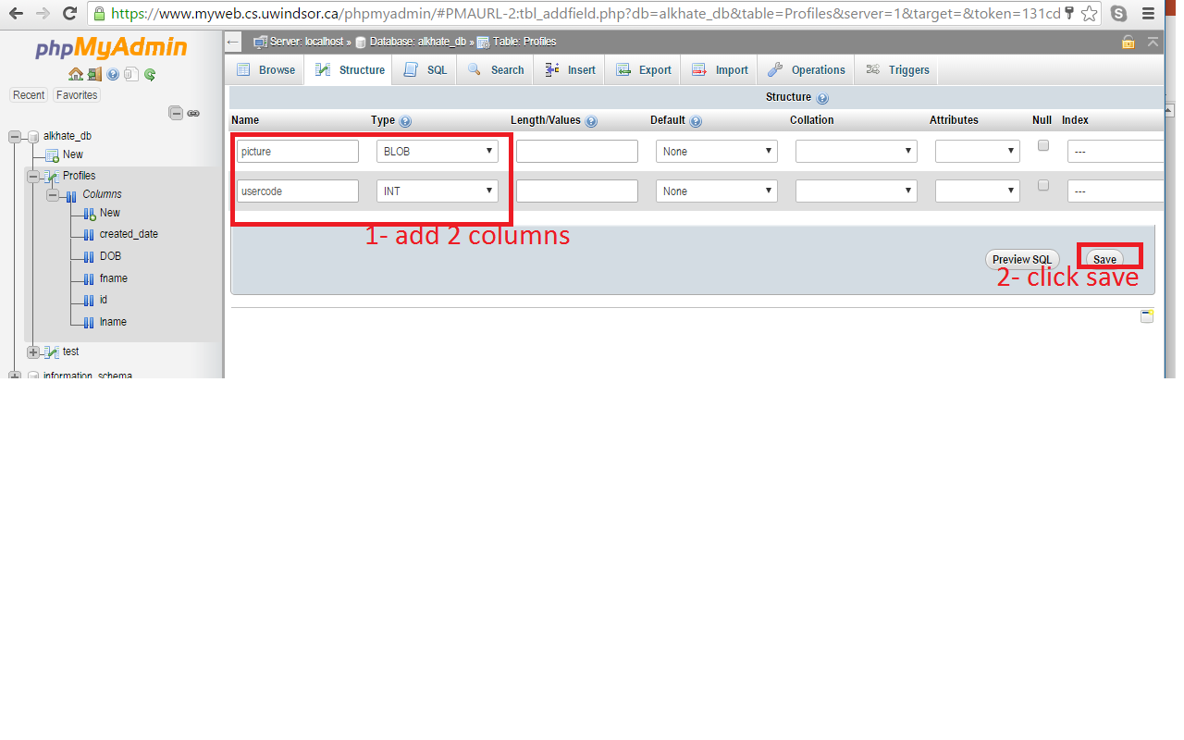
Creating Extra columns

Slide 5
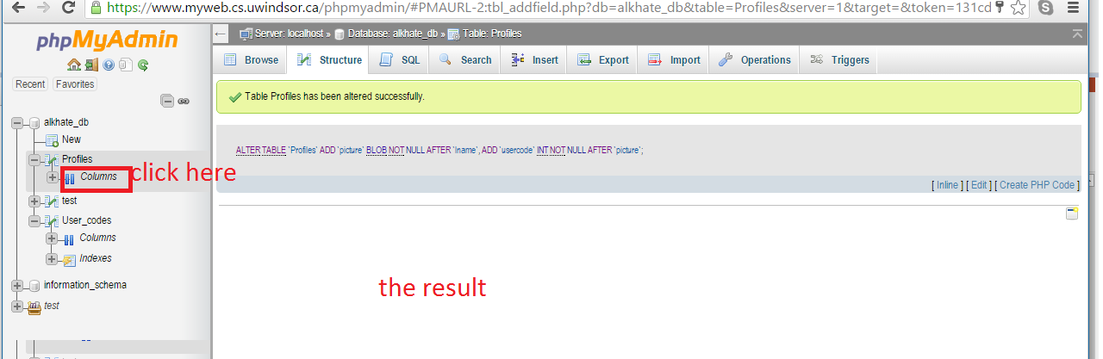
Creating Extra columns

Slide 6
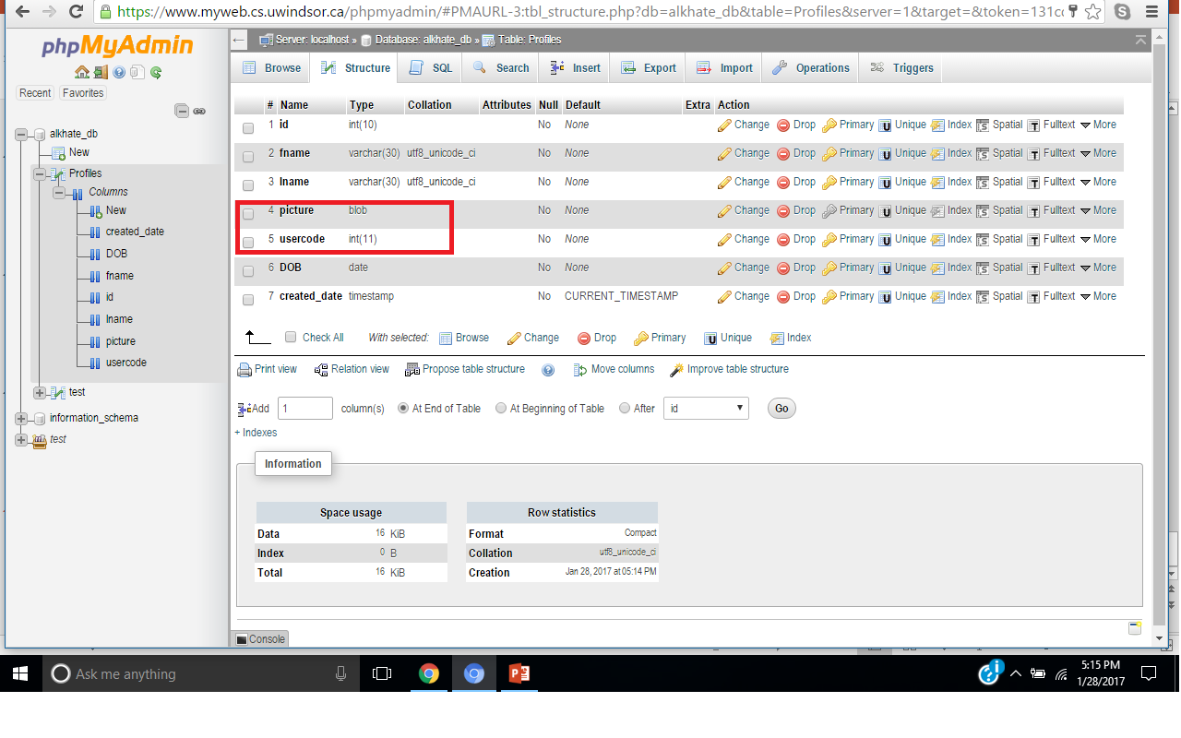
Columns have been created!

Slide 7
Creating lookup table for user codes
Profile is a storage (sometimes called transactional) table that changes so often by adding profiles on daily basis.
Lookup tables usually don’t change that often, once in a while.
The creation process is same, just we categorize them into transnationals r look-ups.

Slide 8
Creating user codes
You need to create a new table called user_codes has the following columns
User_code (INT) Index primary(keep default)
User_desc (VARCHAR) length 30
Created_date (TIMESTAMP) Default Current_timestamp

Slide 9
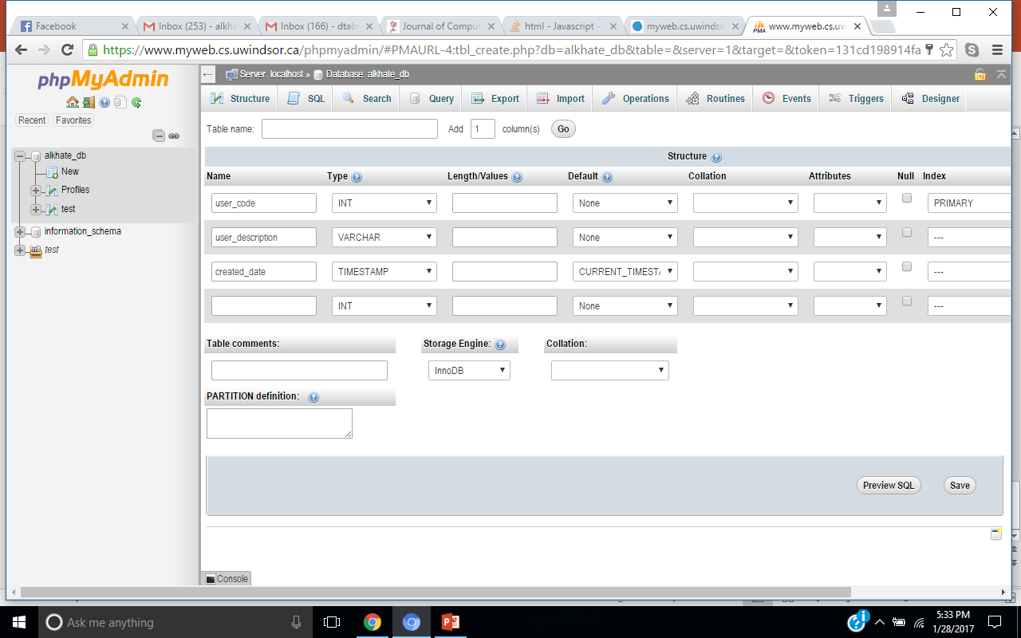
Creating user codes
User_codes
Click save

Slide 10
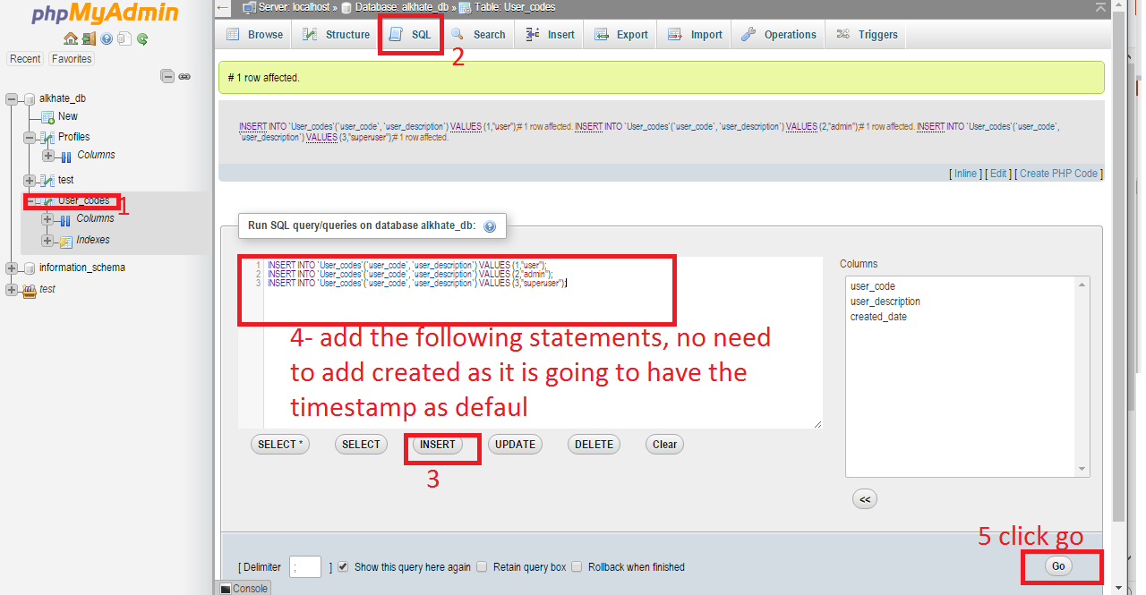
Inserting values t user_codes

Slide 11
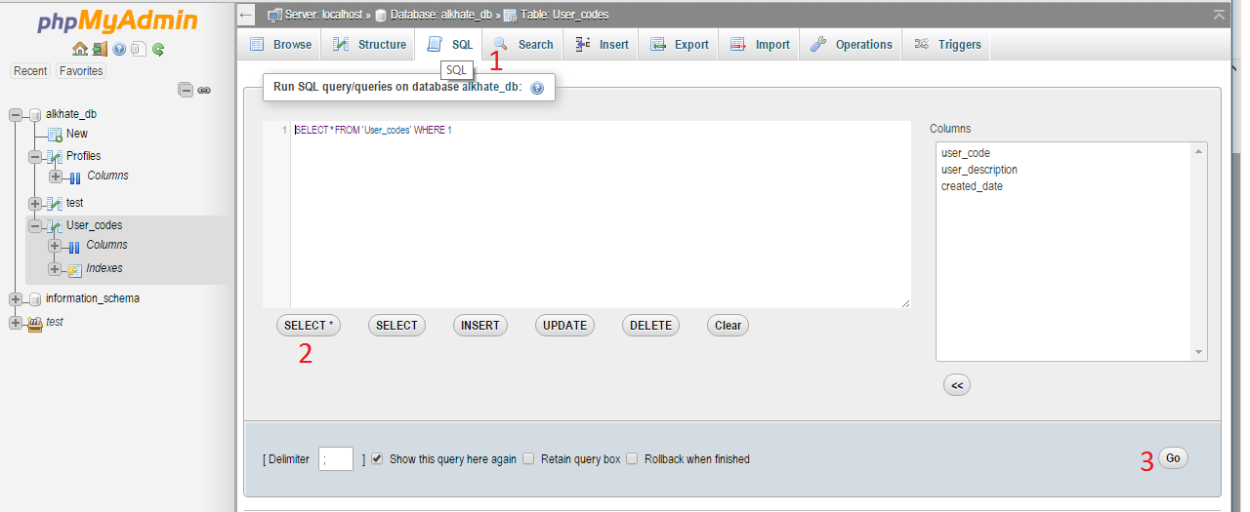
Query user_codes

Slide 12
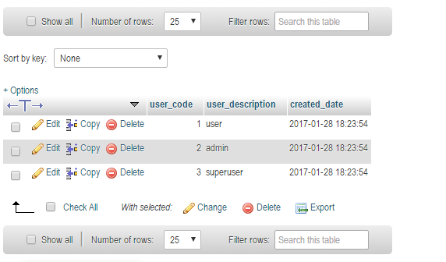
Query user_codes

Slide 13
Linking the 2 tables
User_code attribute in the profiles table has to take the values from user_code attribute in the user_codes tables.
User_code in user_codes table is a primary key
User_code in profiles refers to the primary key , it is called foreign key

Slide 14
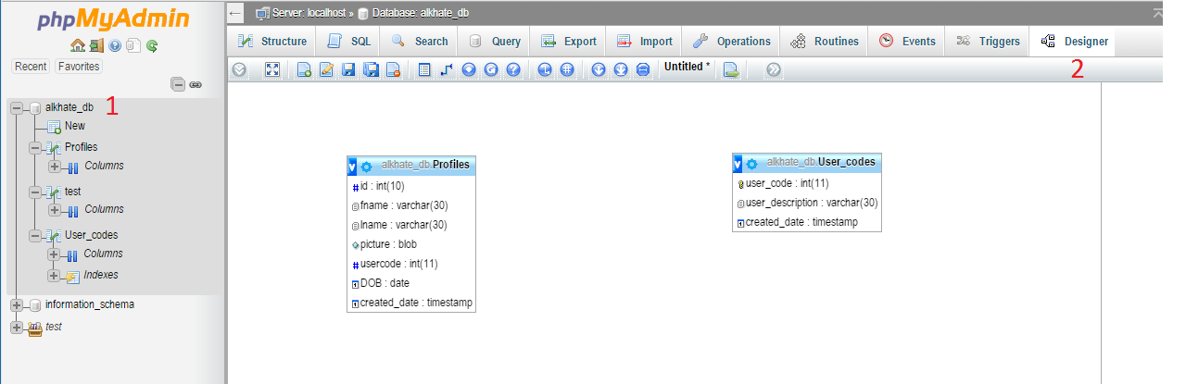
Building the relationship

Slide 15
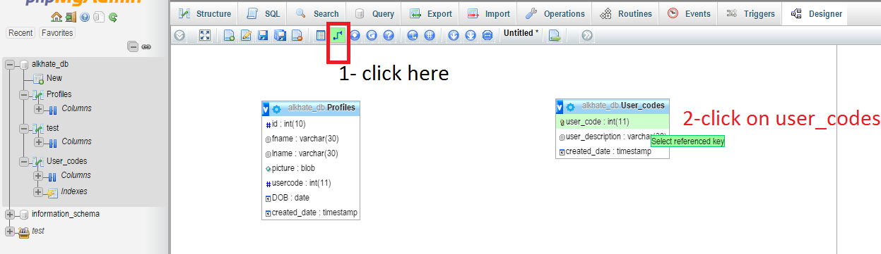
Select the referenced key

Slide 16
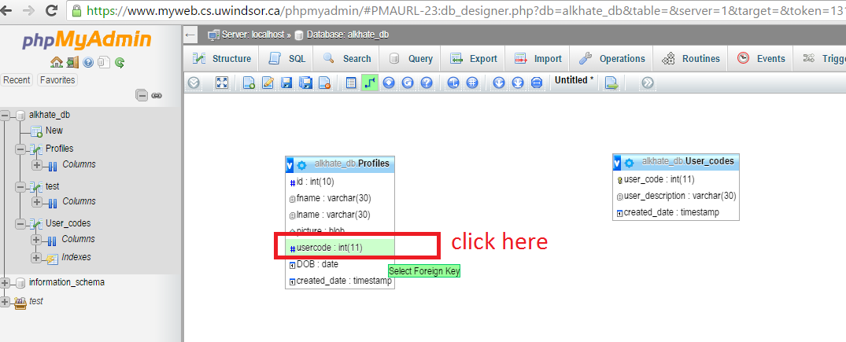
Select the foreign key

Slide 17
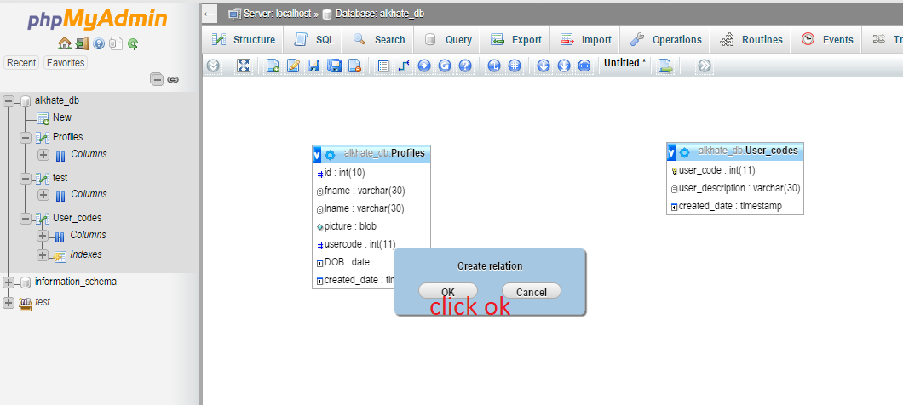
Is it ok?

Slide 18
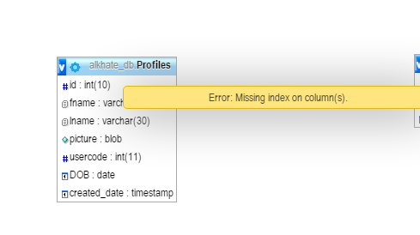
No – index is required!
The foreign key has to have index to be referenced by a foreign key .
Index makes it fast to query that attribute.

Slide 19
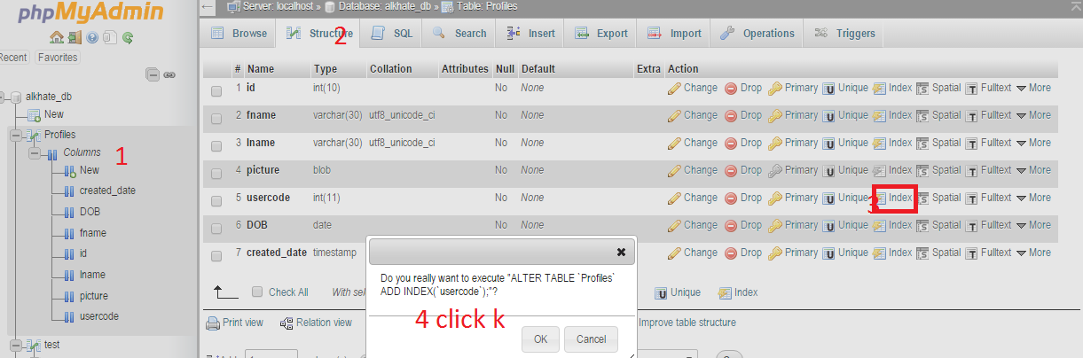
Creating index for the foreign key

Slide 20
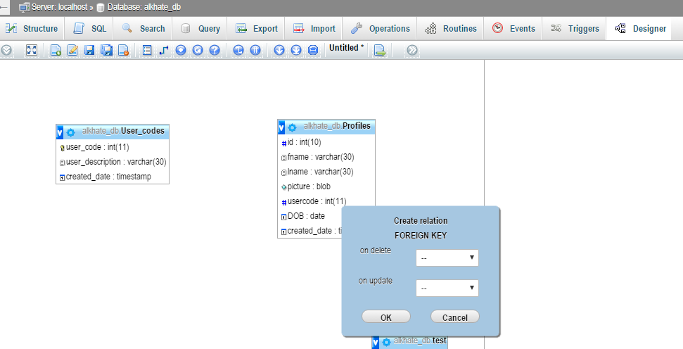
Try creating the relationship again, is it ok?
Click ok

Slide 21
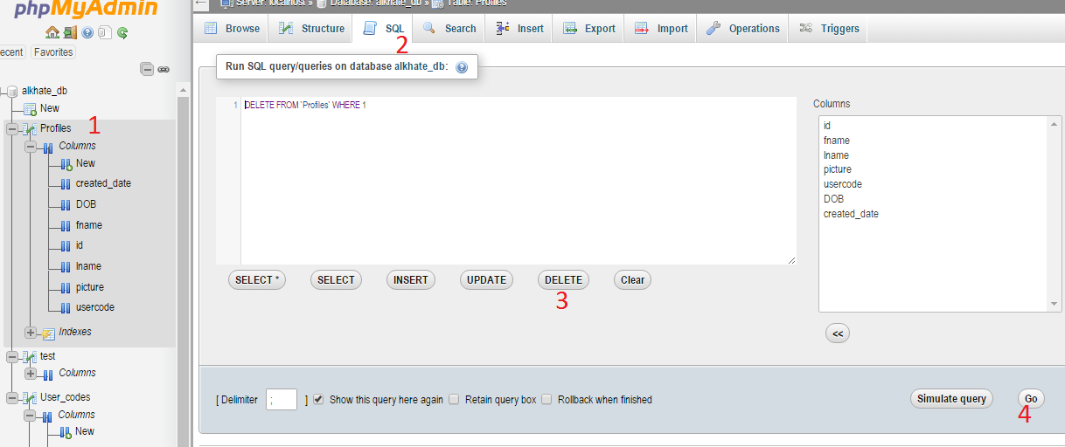
No- record founded in profiles table
Delete all records in profiles

Slide 22
Try again building the relation, should be ok

Slide 23
The relationship is created
Try to insert records in Profiles table again.
Insert NULL for picture attribute. Just for now
Remember the value of user_code in profiles has to match one of the values in the lookup table user_codes.
That means , values should be 1 or 2 or 3
Try inserting 4? Does it work?

